Slide 1
Chapter 3

Slide 2
Objectives

Slide 3
Objectives (cont.)

Slide 4
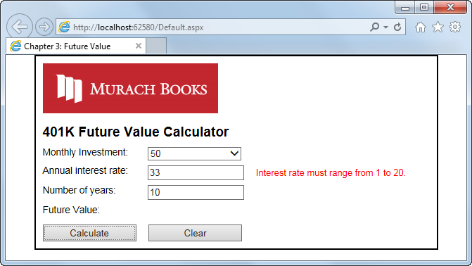
The user interface for the Future Value application

Slide 5
The HTML that’s generated for a new form

Slide 6
The HTML after it has been modified for this application

Slide 7
The aspx code for the Future Value application

Slide 8
The aspx code for the Future Value app (cont.)

Slide 9
The aspx code for the Future Value app (cont.)

Slide 10
The aspx code for the Future Value app (cont.)

Slide 11
The external style sheet for the Future Value application

Slide 12
The external style sheet (cont.)

Slide 13
The external style sheet (cont.)

Slide 14
Common HTML elements

Slide 15
How to code HTML elements

Slide 16
How to code the attributes for HTML elements

Slide 17
How to code an HTML comment

Slide 18
The primary HTML5 semantic elements

Slide 19
A page that’s structured with header, main, and footer elements

Slide 20
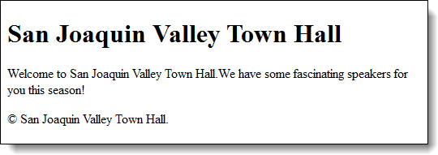
The page displayed in a web browser

Slide 21
The div and span elements

Slide 22
The way div elements were used before HTML5

Slide 23
Span elements in the HTML for a JavaScript application

Slide 24
Span elements generated by ASP.NET for two validators and a label control

Slide 25
Three ways to provide styles

Slide 26
Three ways to provide styles (cont.)

Slide 27
A head element that includes two external style sheets

Slide 28
How to generate a link element for an external style sheet

Slide 29
HTML that can be selected by type, class, or id

Slide 30
Three rule sets with type selectors

Slide 31
Two rule sets with class selectors

Slide 32
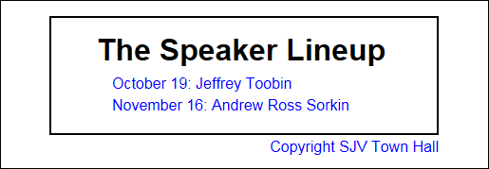
The elements displayed in a browser

Slide 33
Some of the styles in the external style sheet for the Future Value application

Slide 34
Some of the styles for the Future Value app (cont.)

Slide 35
The current browsers and their HTML5 ratings (perfect score is 555)

Slide 36
The code that includes the JavaScript shiv for HTML5 compatibility

Slide 37
The URL for downloading the normalize.css style sheet

Slide 38
IntelliSense as an HTML element is entered in Source view

Slide 39
The smart indent feature

Slide 40
Other Video Studio features for entering HTML

Slide 41
Types of disabilities

Slide 42
IntelliSense with a list of WAI-ARIA values

Slide 43
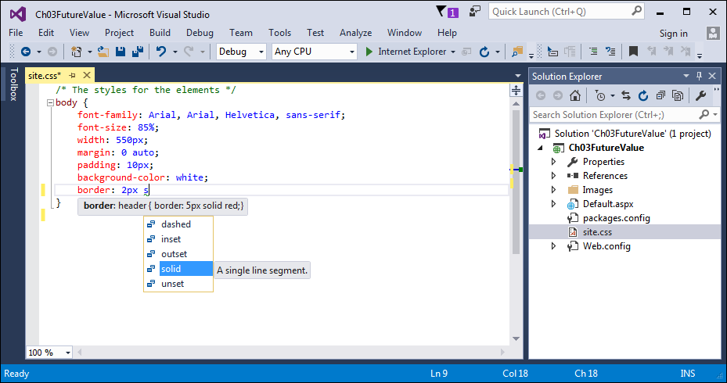
An external style sheet in Visual Studio

Slide 44
How to create an external style sheet

Slide 45
How to enter and edit the styles for an external style sheet

Slide 46
How to comment out and uncomment CSS rules

Slide 47
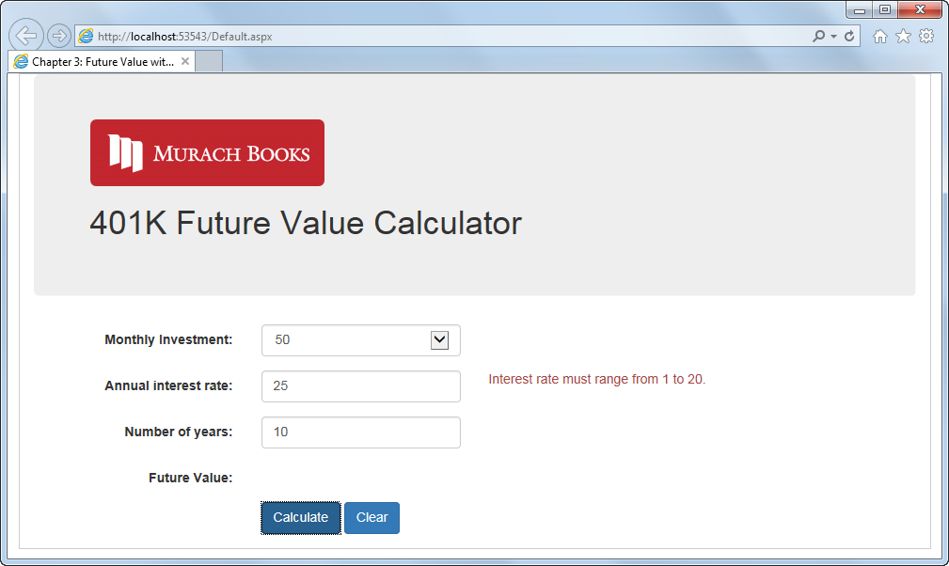
The responsive Future Value application at desktop width

Slide 48
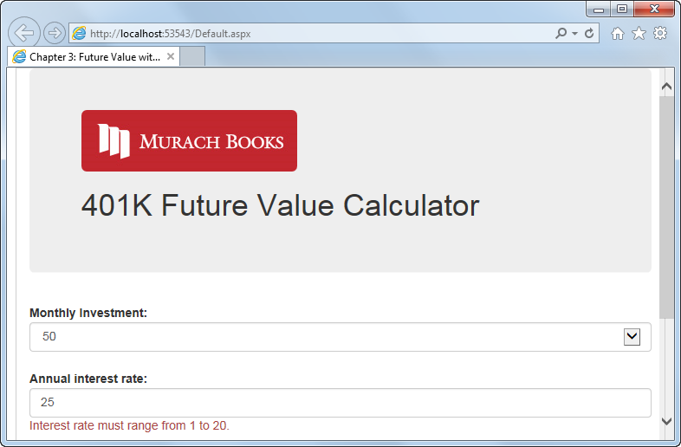
The responsive Future Value application at tablet width

Slide 49
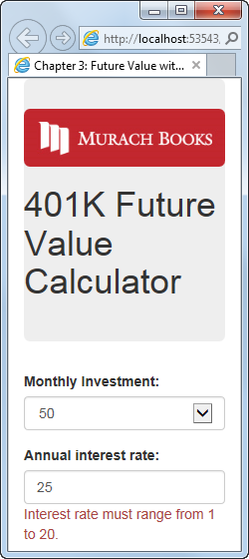
The responsive Future Value application at smart phone width

Slide 50
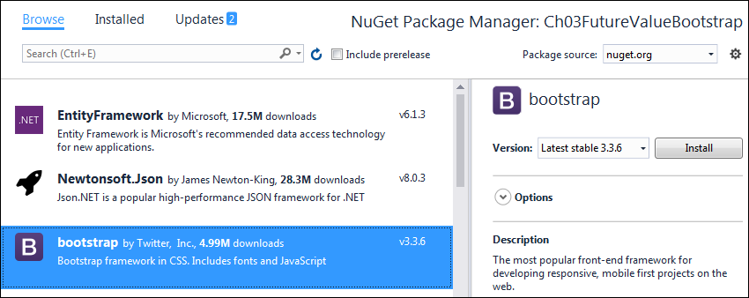
The NuGet Package Manager page

Slide 51
How to add the Bootstrap Nuget package to your web application

Slide 52
How to add Bootstrap to a web form

Slide 53
Some of the CSS classes of the Bootstrap grid system

Slide 54
An element that spans four columns on medium and large screens

Slide 55
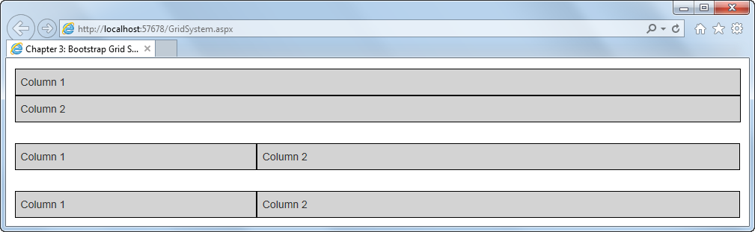
A Bootstrap grid on a medium screen

Slide 56
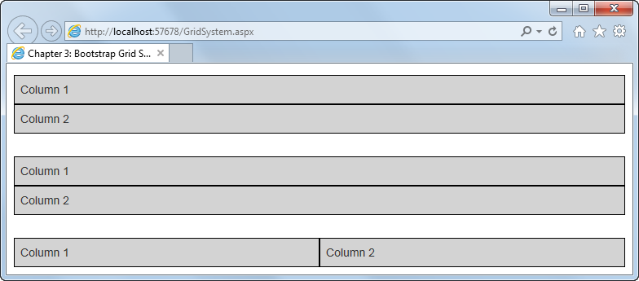
A Bootstrap grid on a small screen

Slide 57
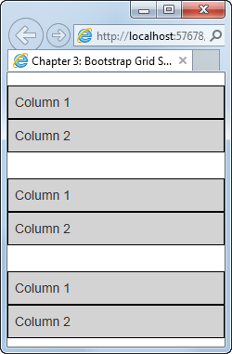
A Bootstrap grid on an extra small screen

Slide 58
The HTML for the grid example

Slide 59
The CSS that augments the Bootstrap CSS classes

Slide 60
Some of the Bootstrap CSS classes for working with forms

Slide 61
A form with two text boxes in vertical layout

Slide 62
A form with two text boxes in horizontal layout

Slide 63
Some of the Bootstrap CSS classes for working with buttons

Slide 64
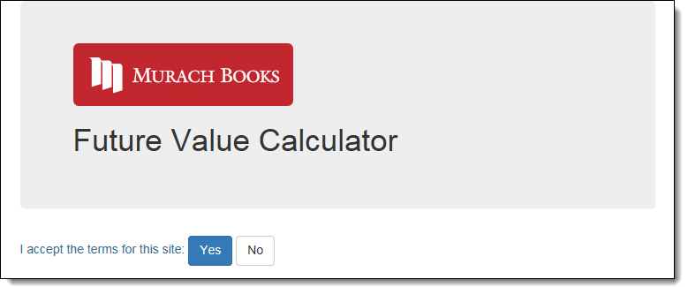
A form with a jumbotron, an image, and two buttons

Slide 65
The HTML for the form

Slide 66
The aspx code for the Future Value application

Slide 67
The aspx code for the Future Value app (cont.)

Slide 68
The aspx code for the Future Value app (cont.)

Slide 69
The aspx code for the Future Value app (cont.)

Slide 70
The aspx code for the Future Value app (cont.)

Slide 71
The custom style sheet for the Future Value application

Slide 72
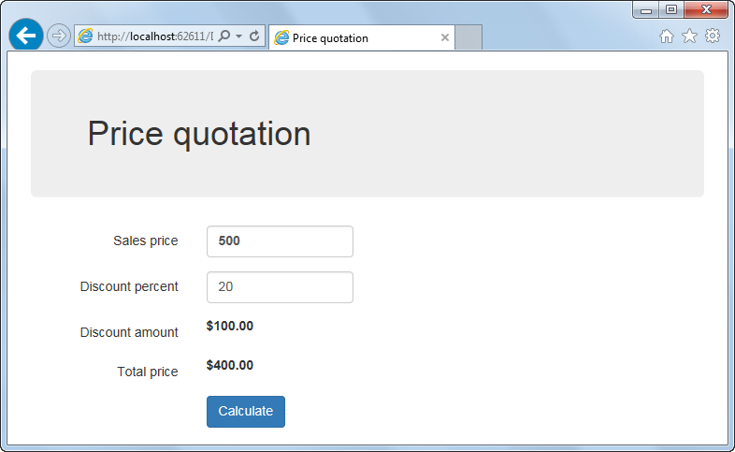
Extra 3-1 Use CSS and Bootstrap to format the Quotation application

